Slide 1

Demystifying hourglass genes
Nikola Kalábová

Slide 2
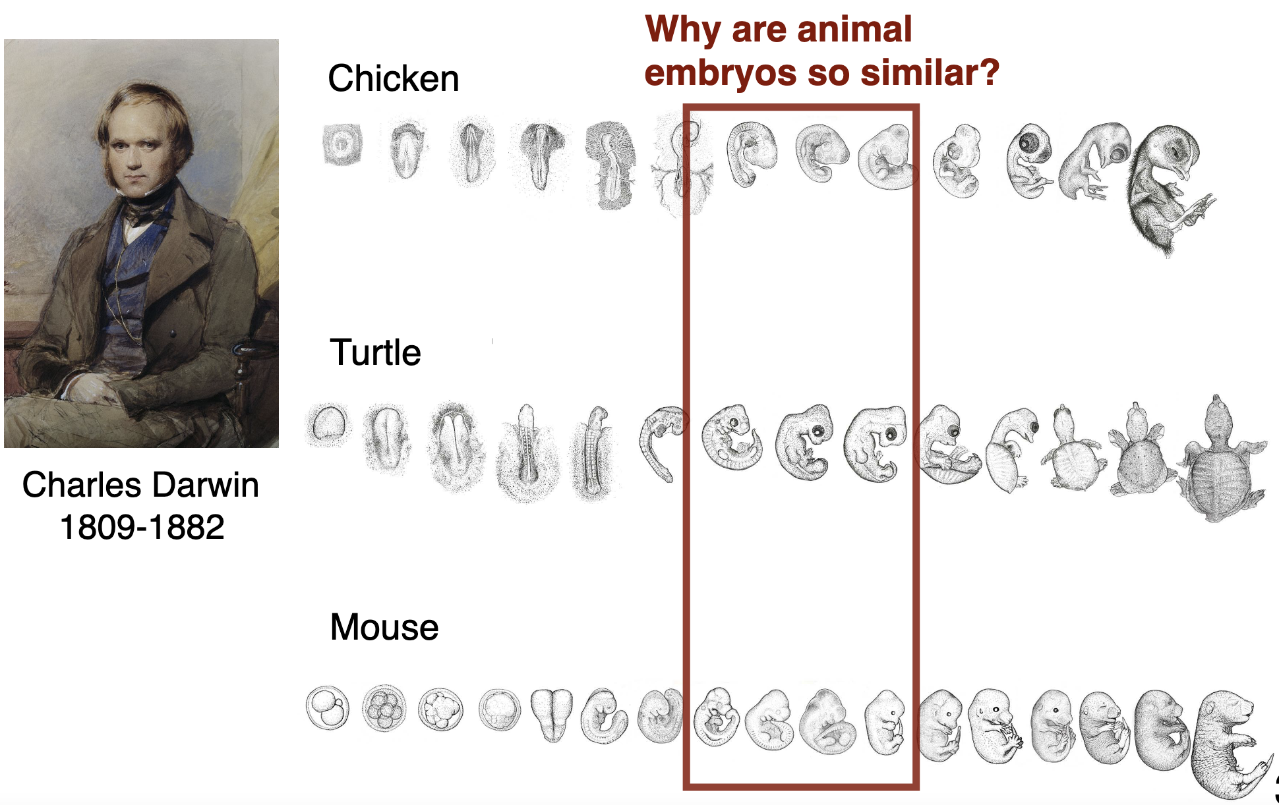

Slide 3
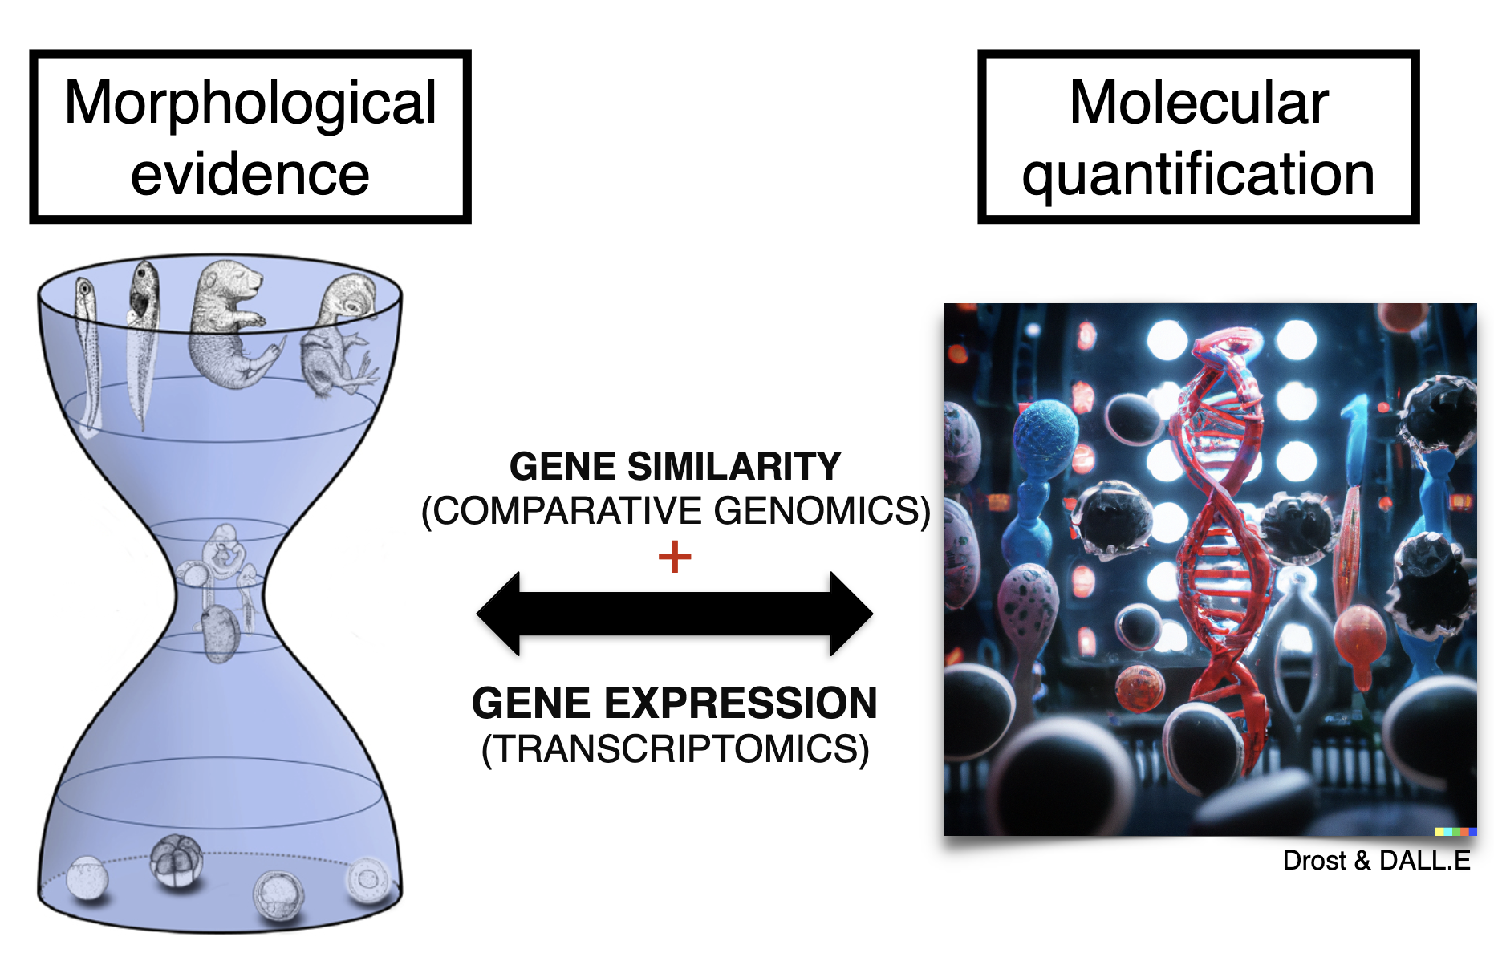

Slide 4
Phylostrata (ps)
Phylostrata trace the evolutionary origin of each gene based on the identification of homologous sequences in other species along the tree of life
Assignment to one of 12 defined age categories
Low PS values = evolutionarily old genes

Slide 5
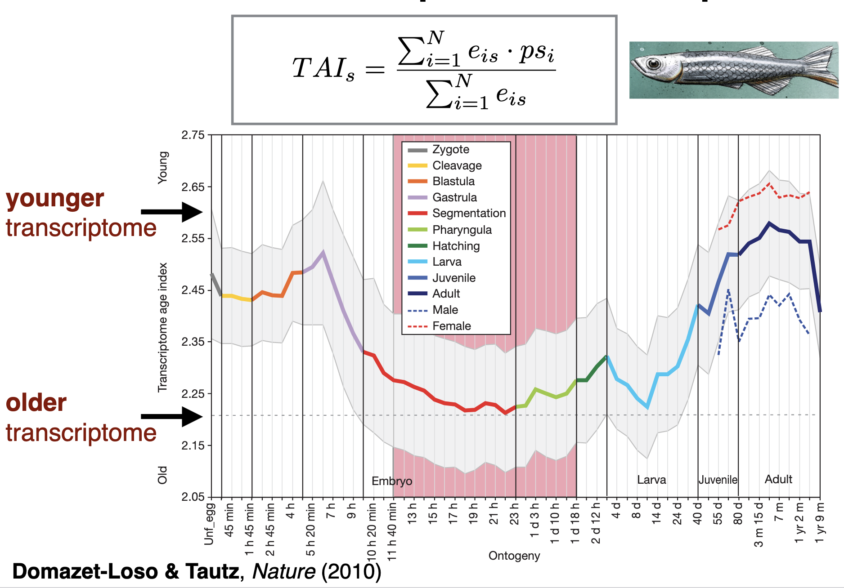
Transcriptome age index (TAI)

Slide 6
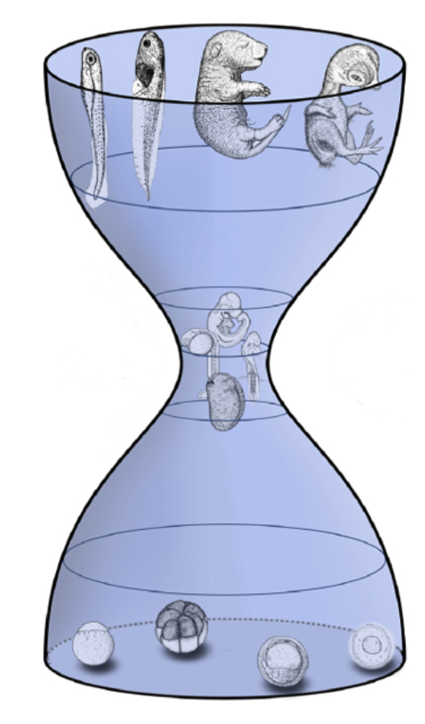
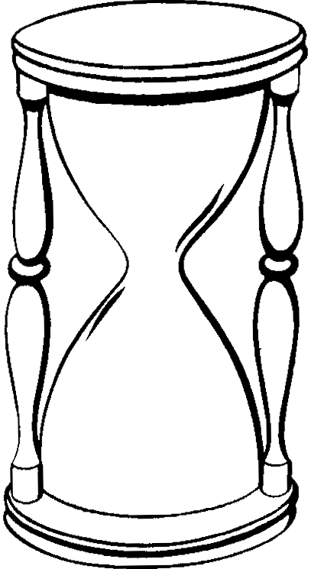
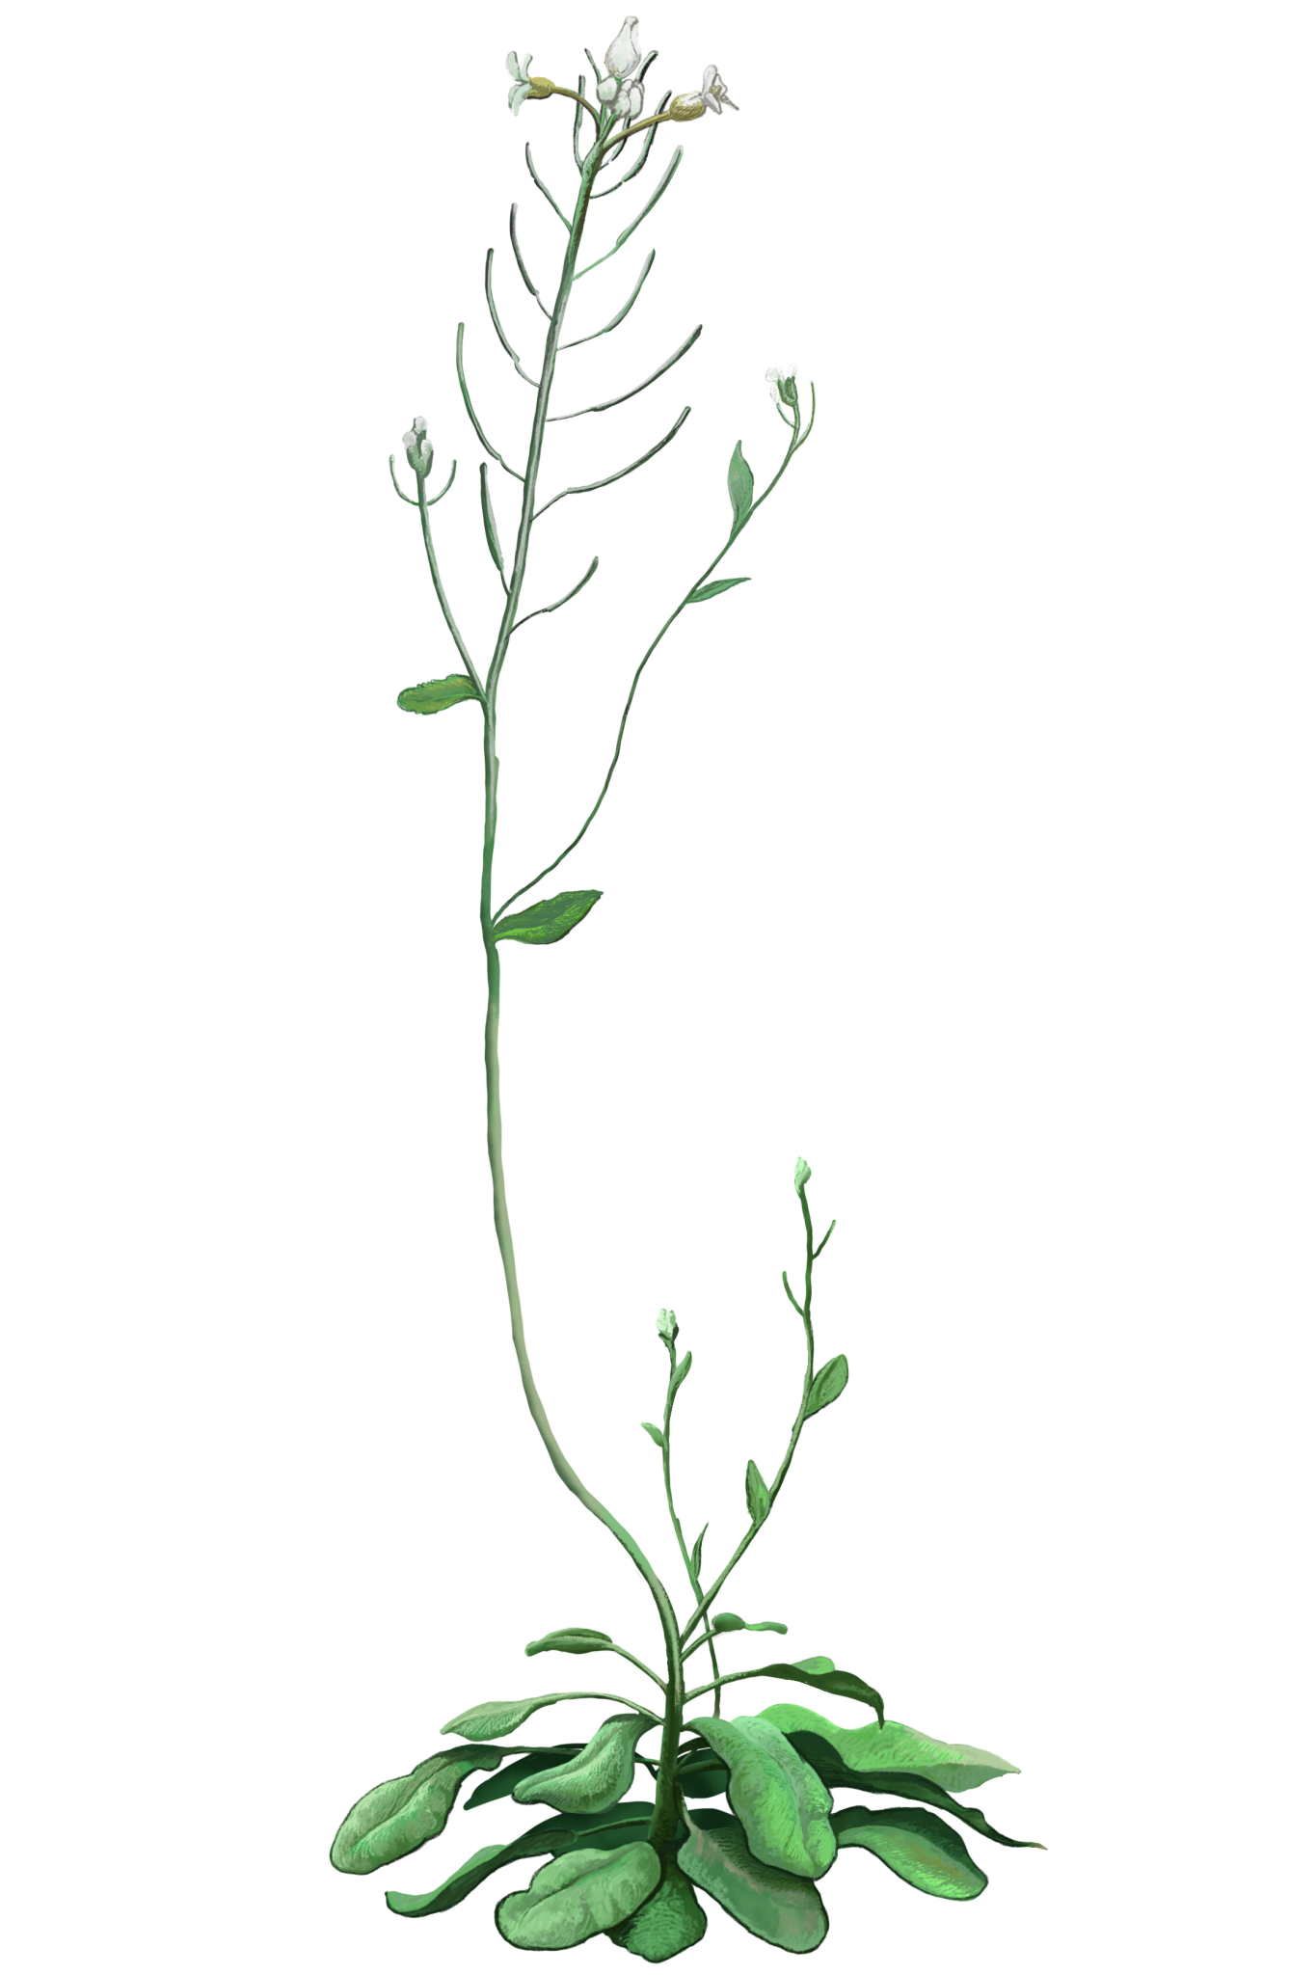
Hourglass in plants
?

Slide 7
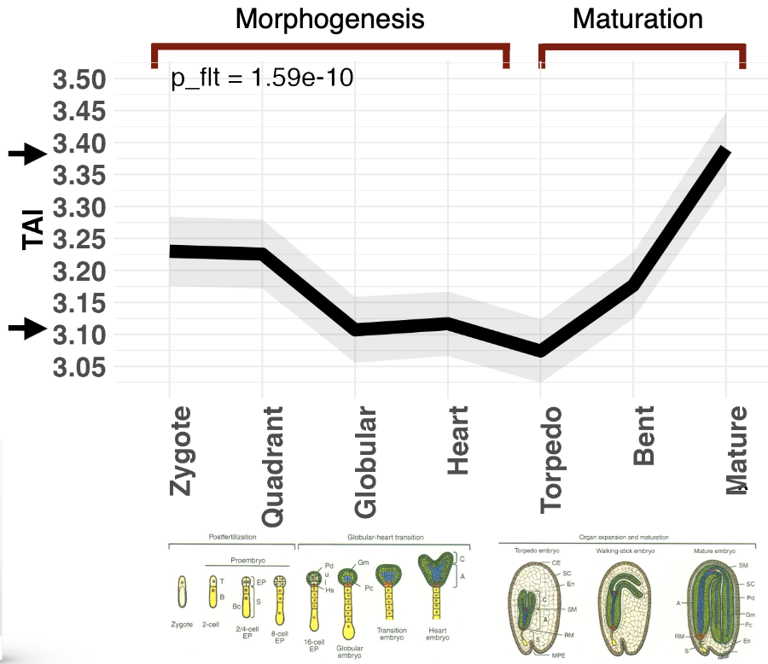
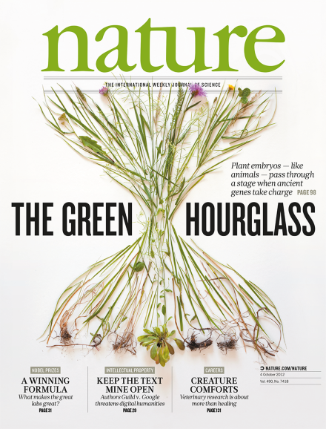
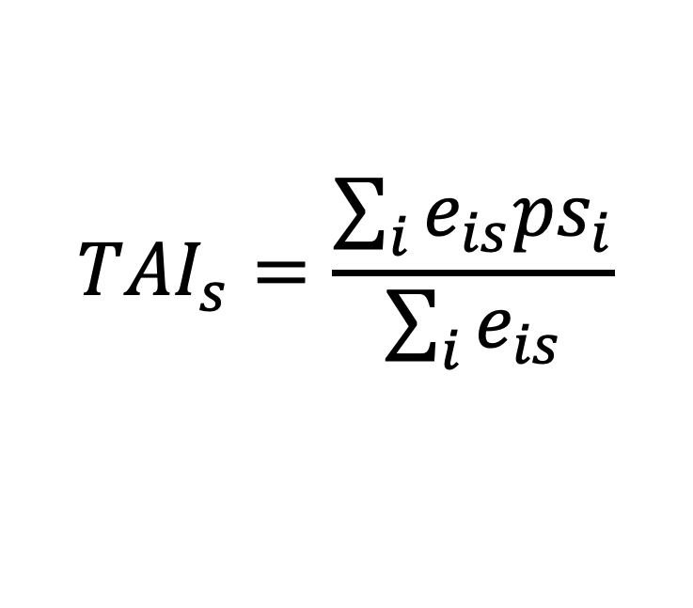
Hourglass in plants
$${TAI}_{s}=\frac{\sum_{i}{e_{is}{ps}_{i}}}{\sum_{i}{e_{is}}}$$
Quint, Drost et al., Nature (2012)
Drost et al., Mol. Biol. Evol. (2015)

Slide 8
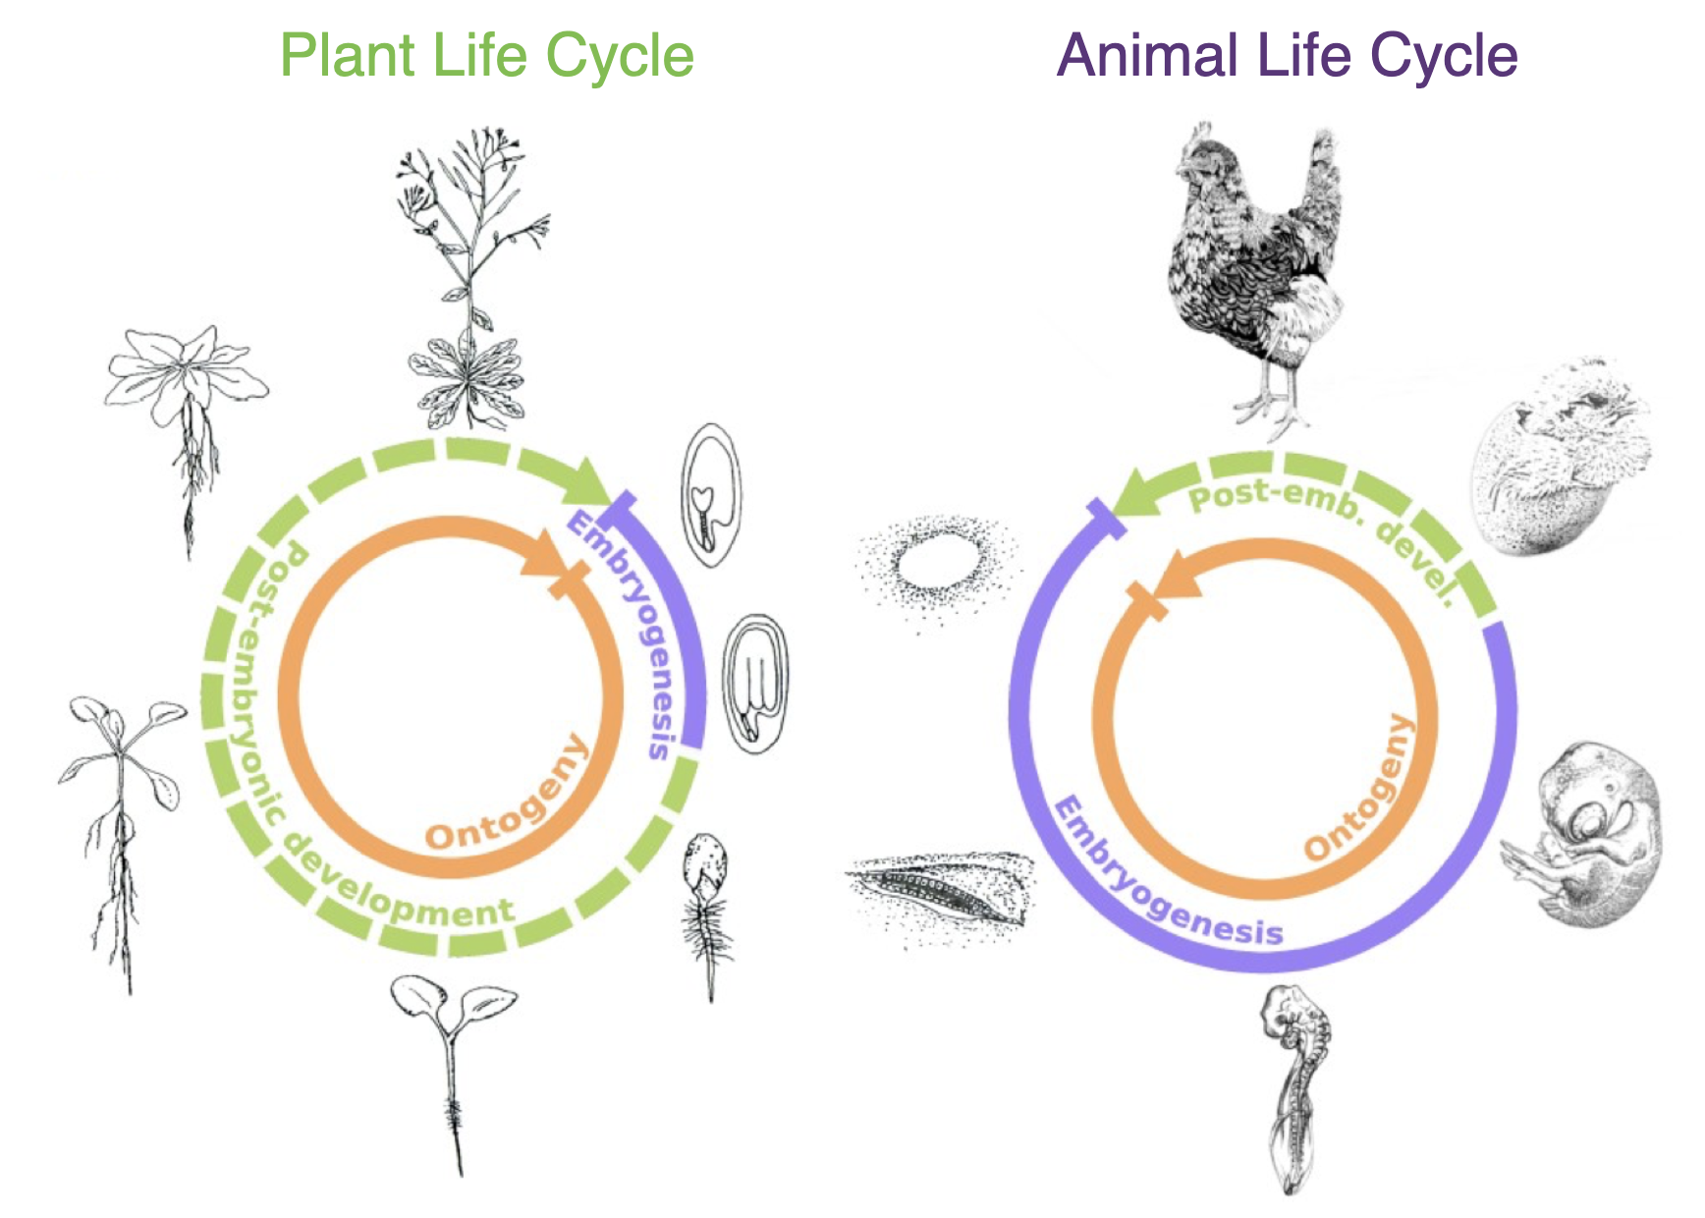
Hourglass in plants
Drost et al., Mol. Biol. Evol. (2015)

Slide 9
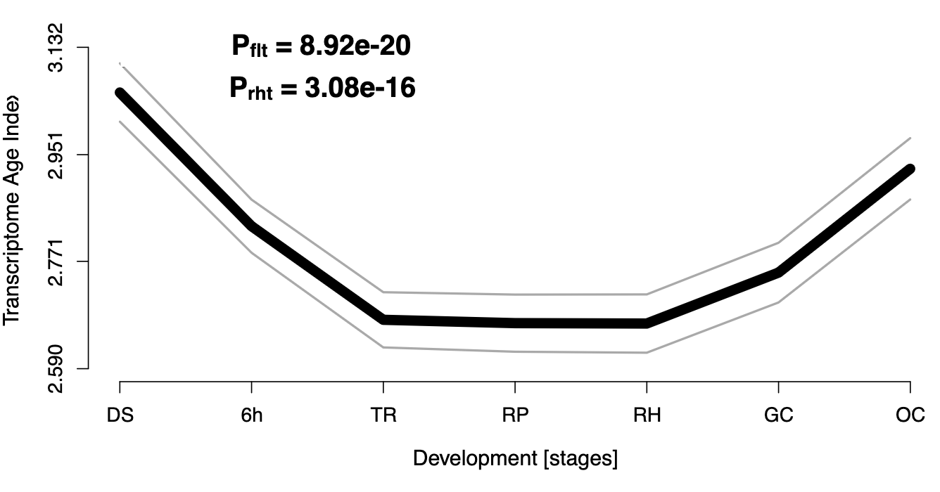
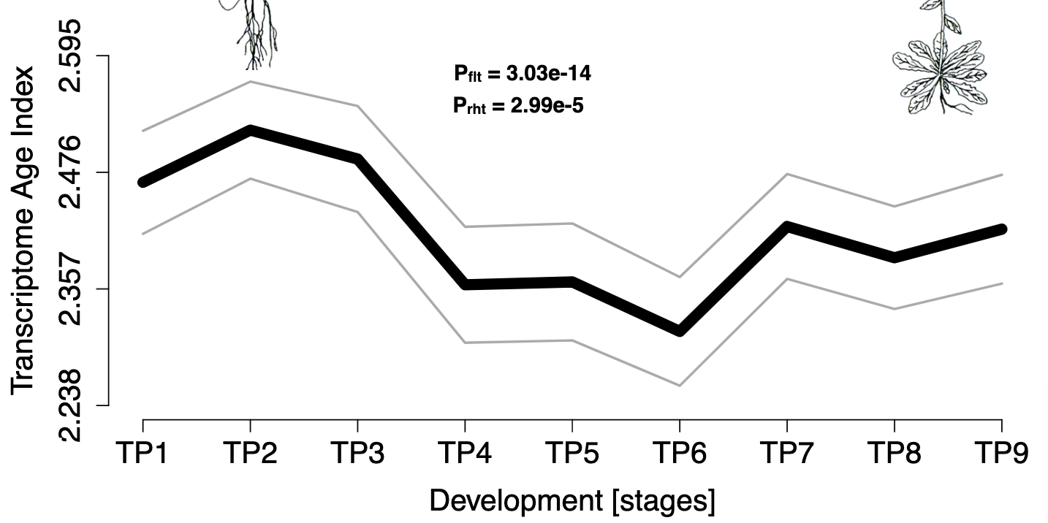
Hourglass in plants
Seed germination
Flowering
Drost et al., Mol. Biol. Evol. (2015)

Slide 10
What are those genes responsible for hourglass?

Slide 11
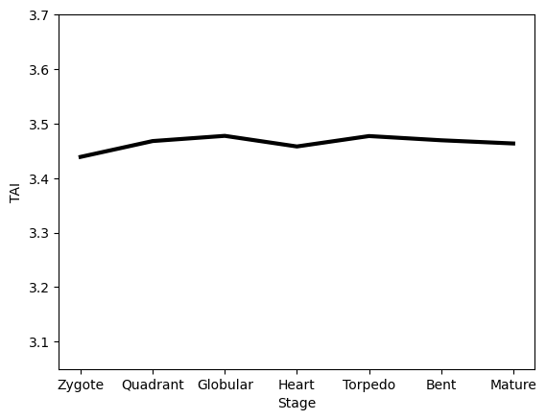
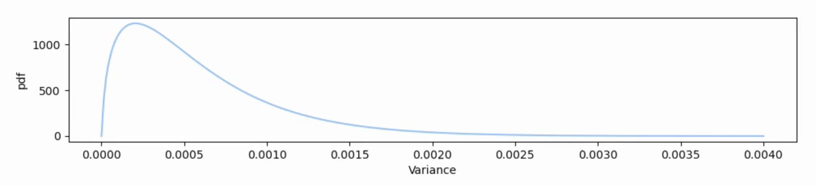
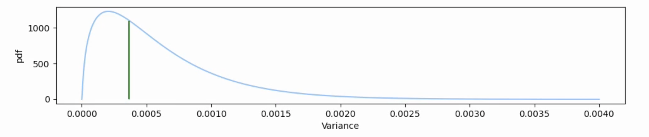
Flat line test
Permute ps values
Compute variance of TAI curve
Estimate gamma distribution
Compute p-value

Slide 12
Genetic algorithms
Complex scoring functions
Problems benefiting from combining multiple solutions
Straightforward encoding

Slide 13
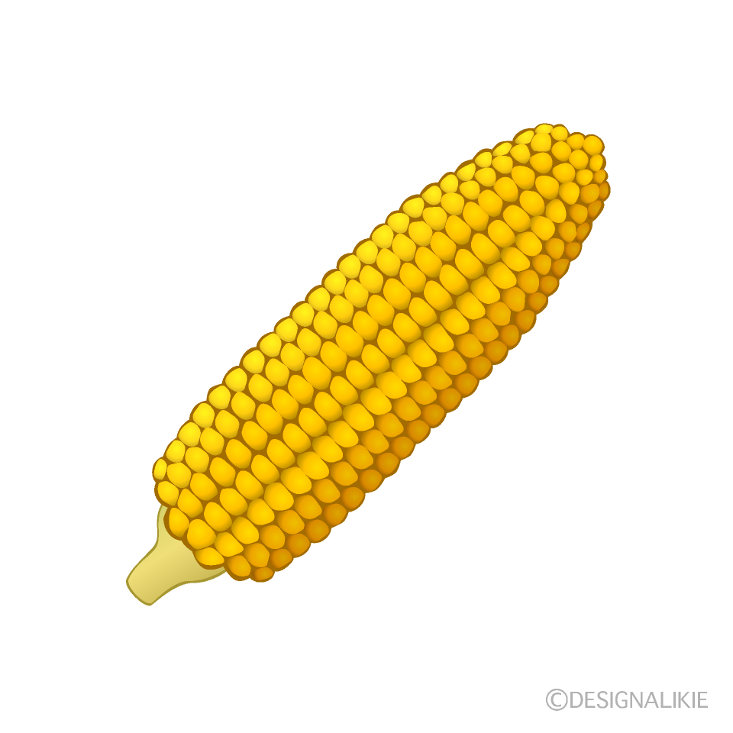
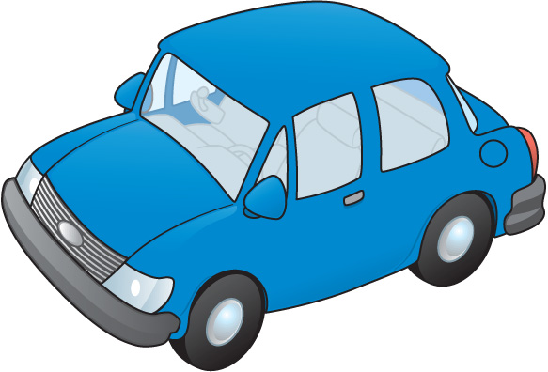


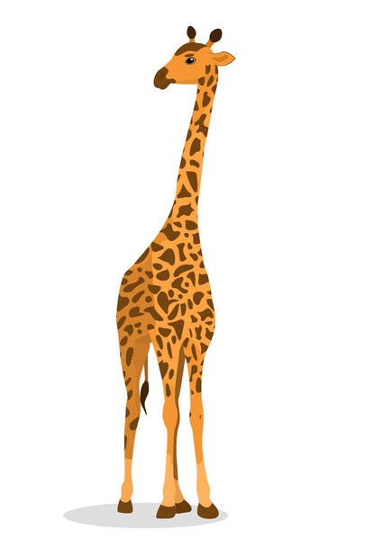
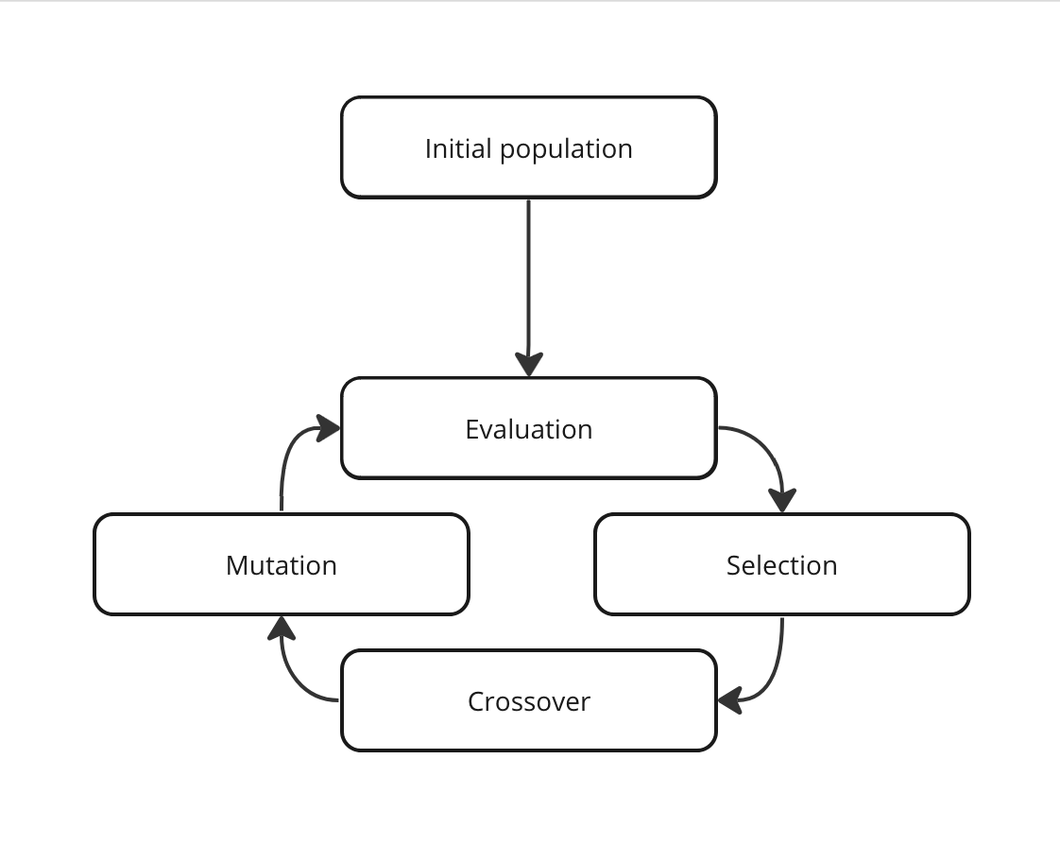
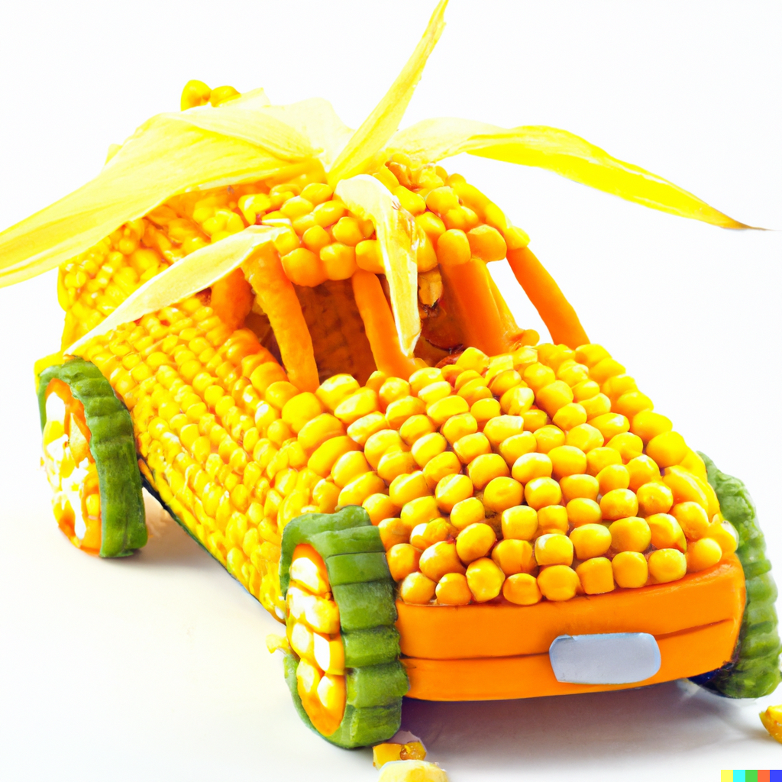
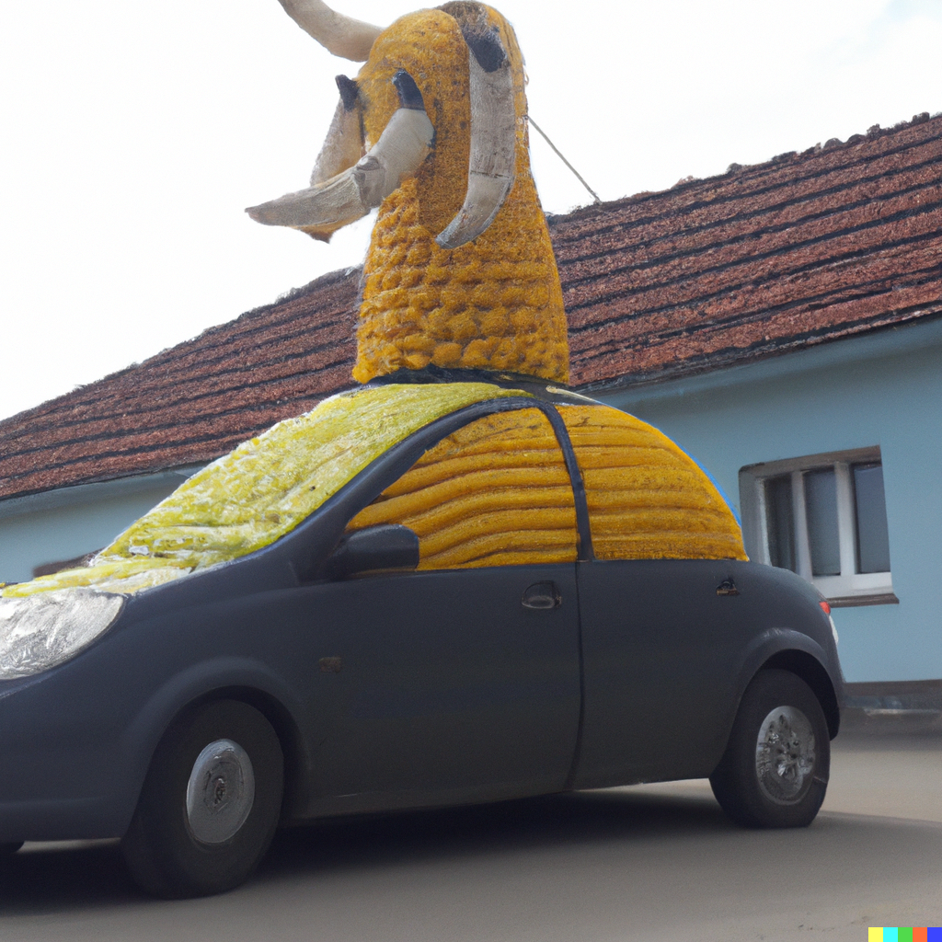
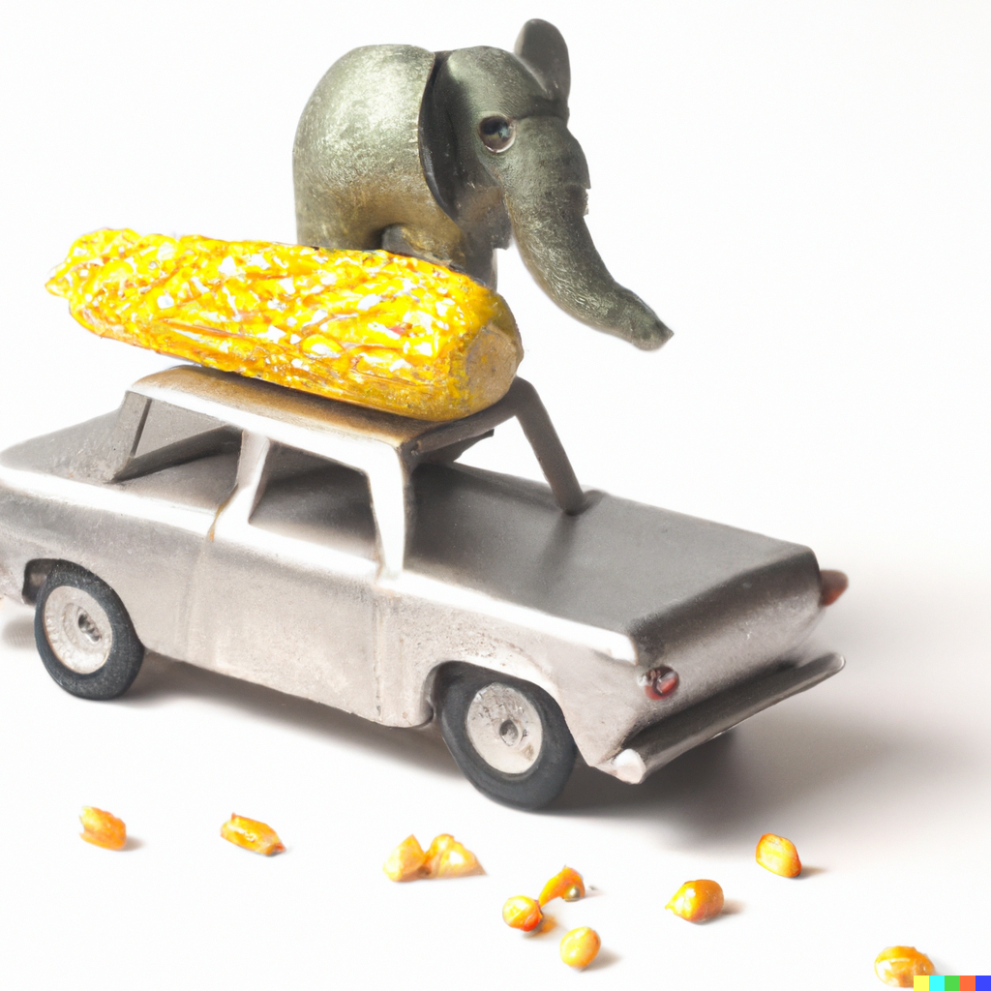
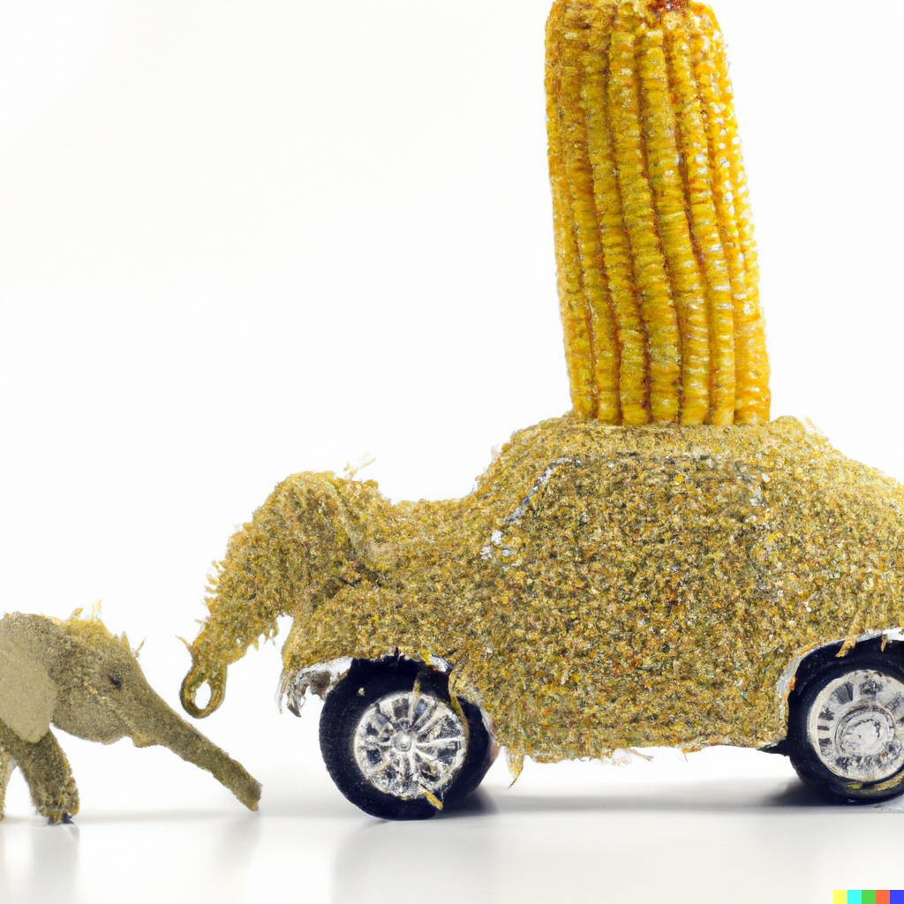
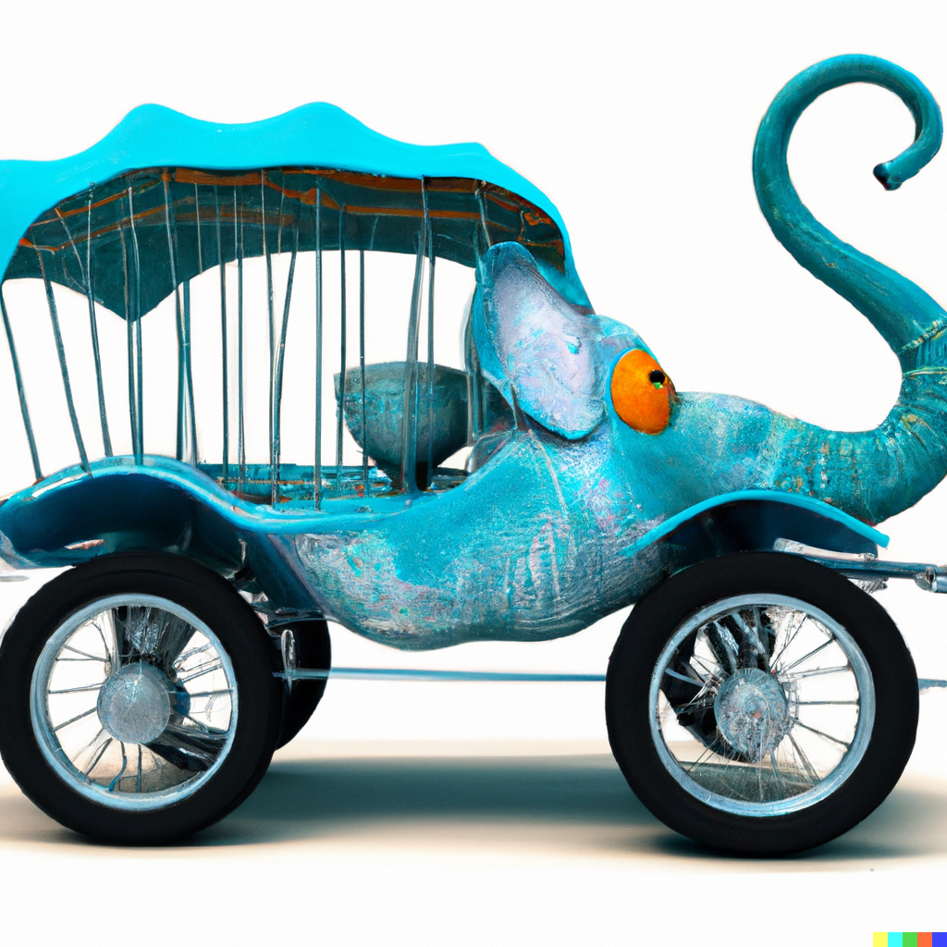
Elephant in the shape of a car with a corn on top of it
5
5
0
5
0

Slide 14
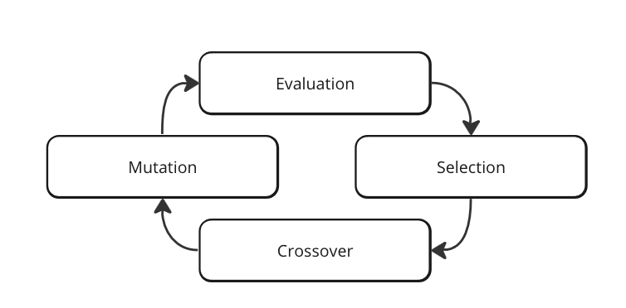
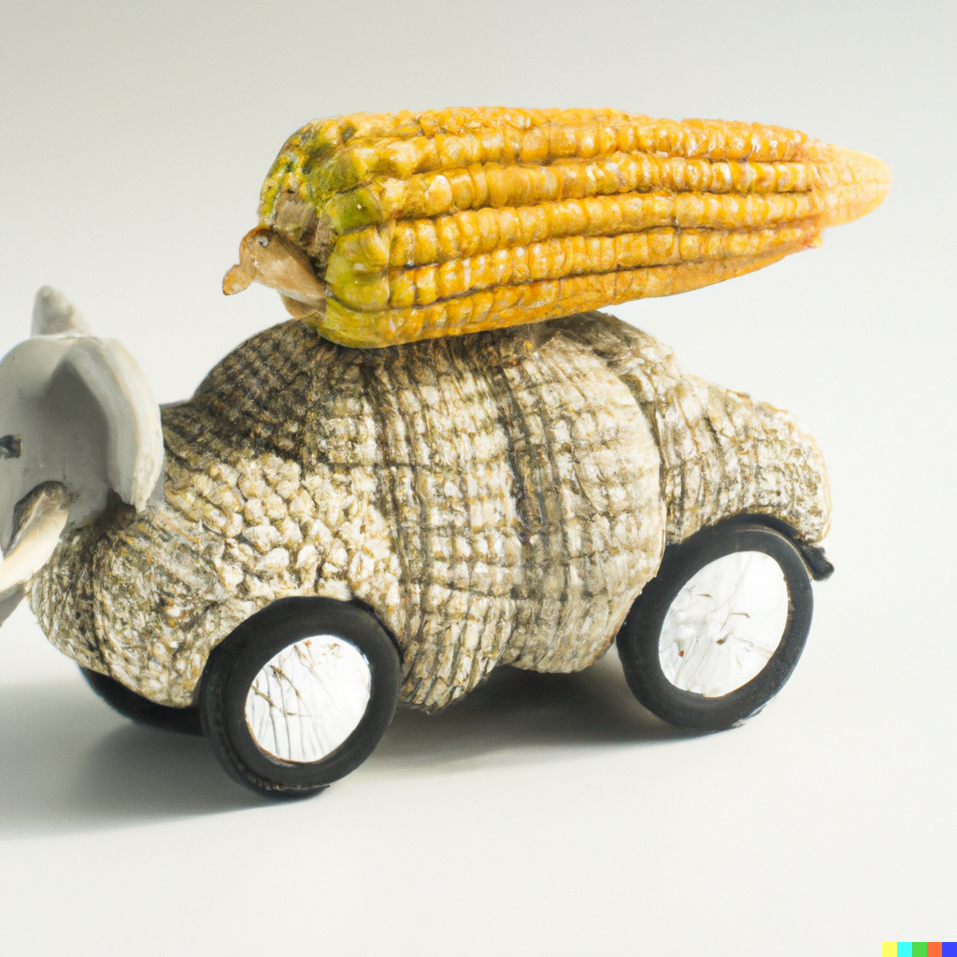
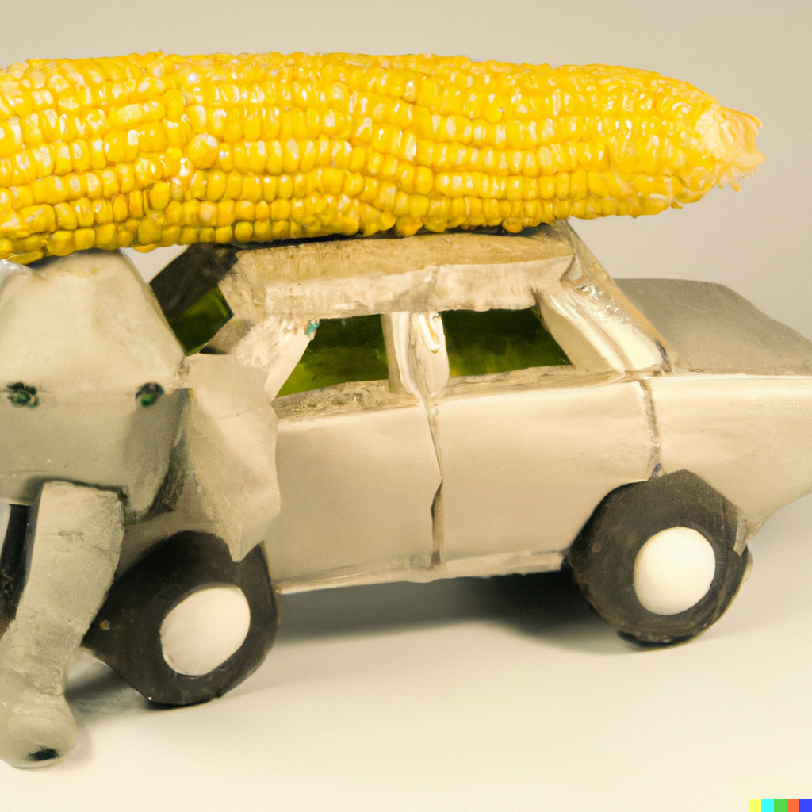
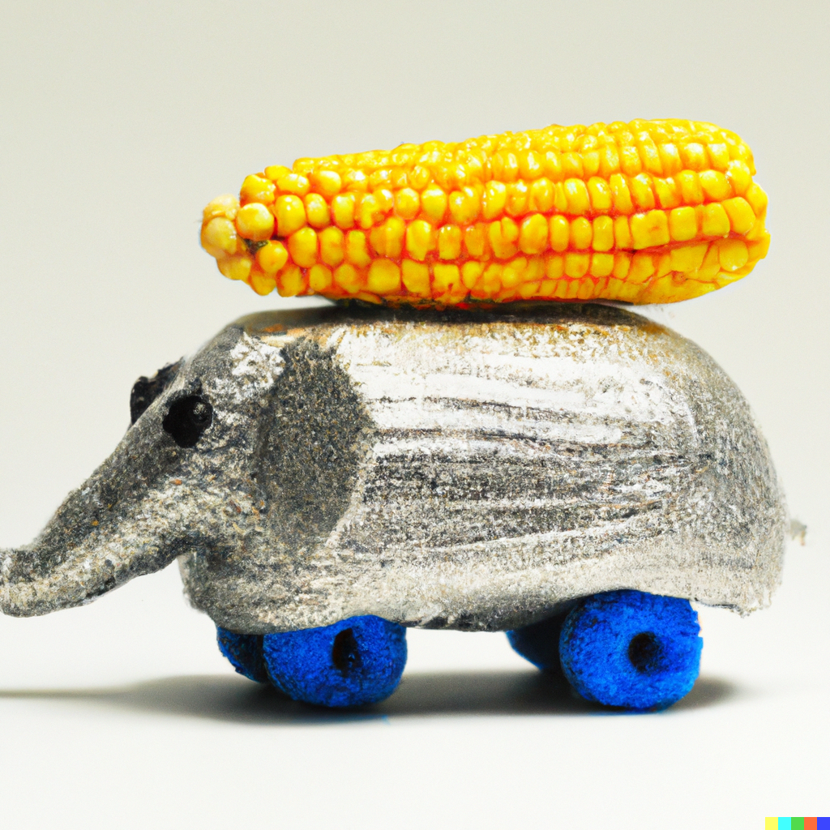
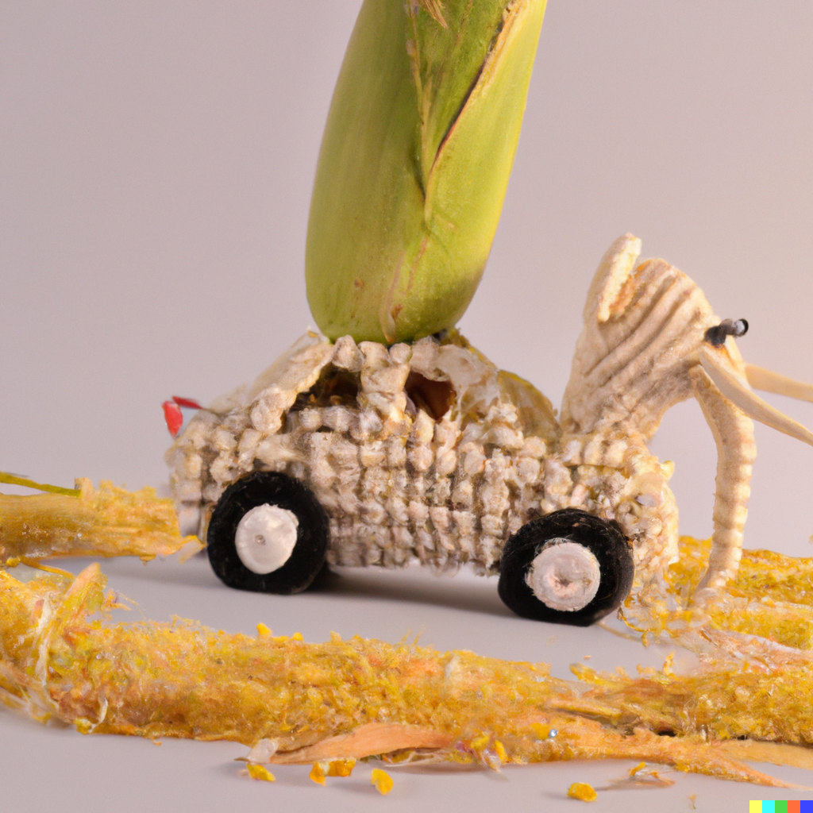
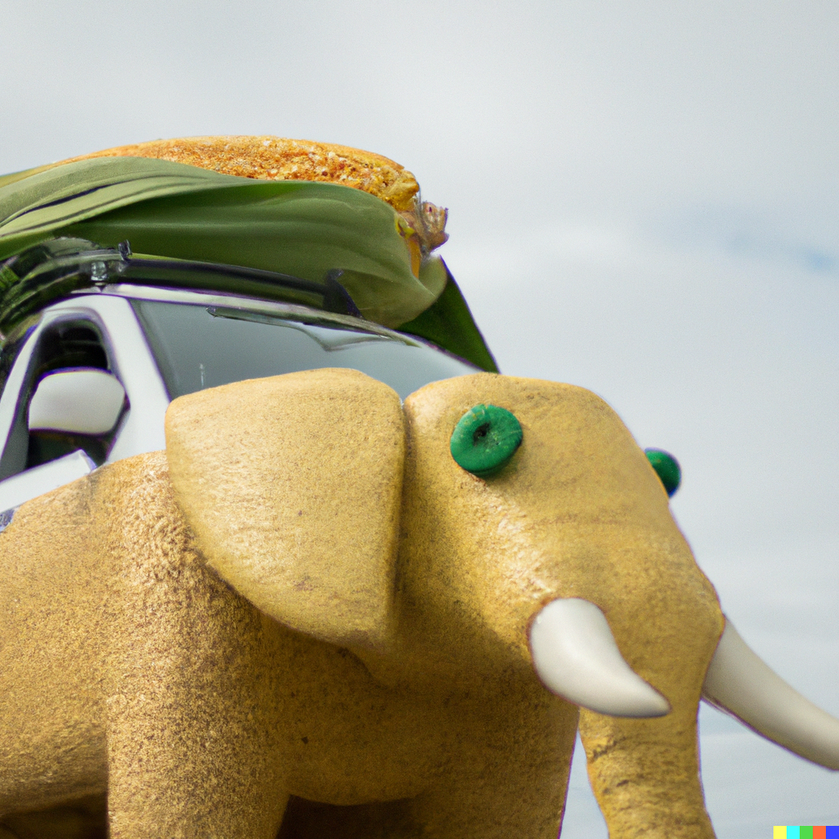
Genetic algorithms
3
2
5
6
5

Slide 15
Genetic algorithms
10
15
13
8
14

Slide 16
Genetic algorithm for hourglass

Slide 17
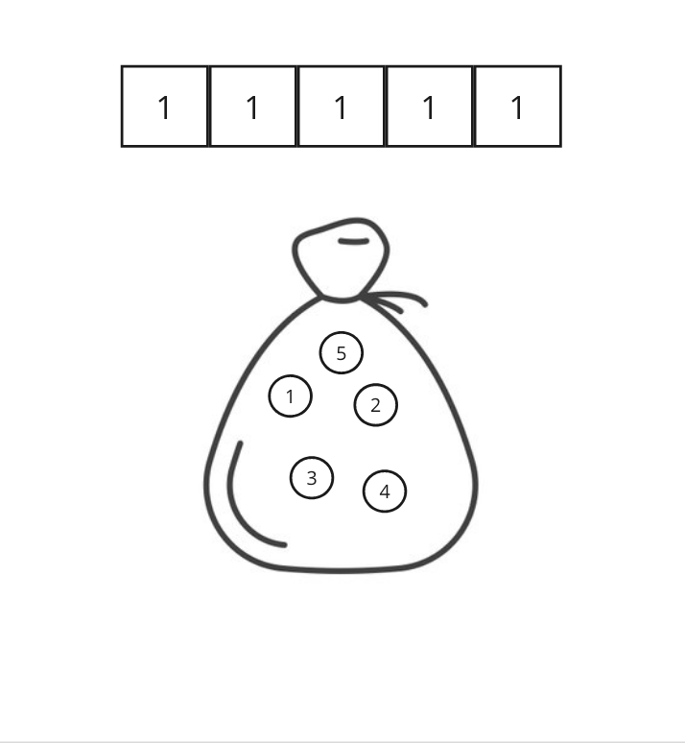
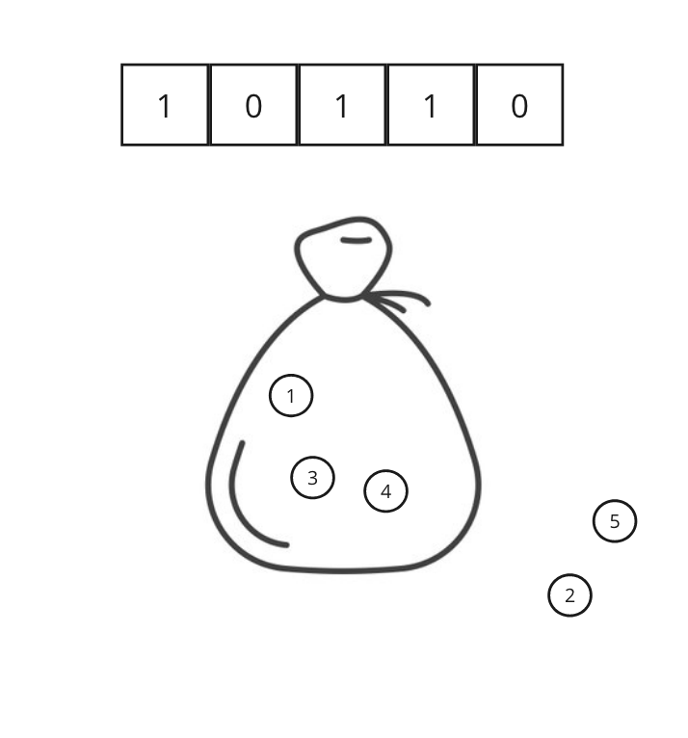
Problem encoding

Slide 18
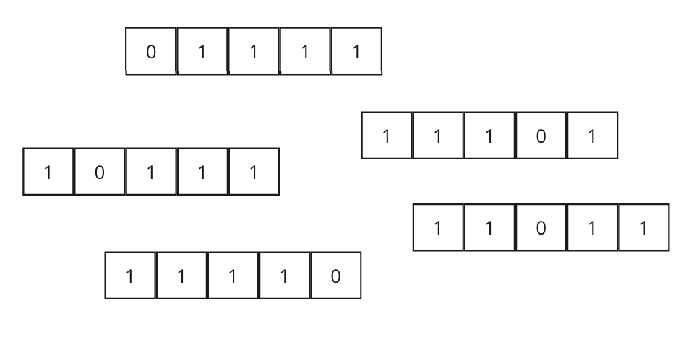
Initial population

Slide 19

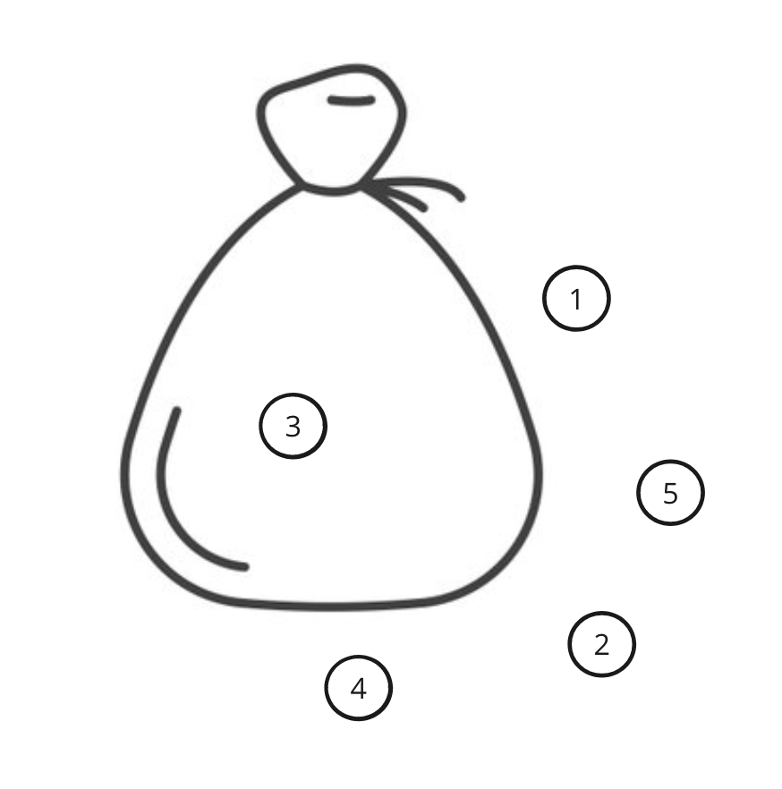
Fitness function

Slide 20
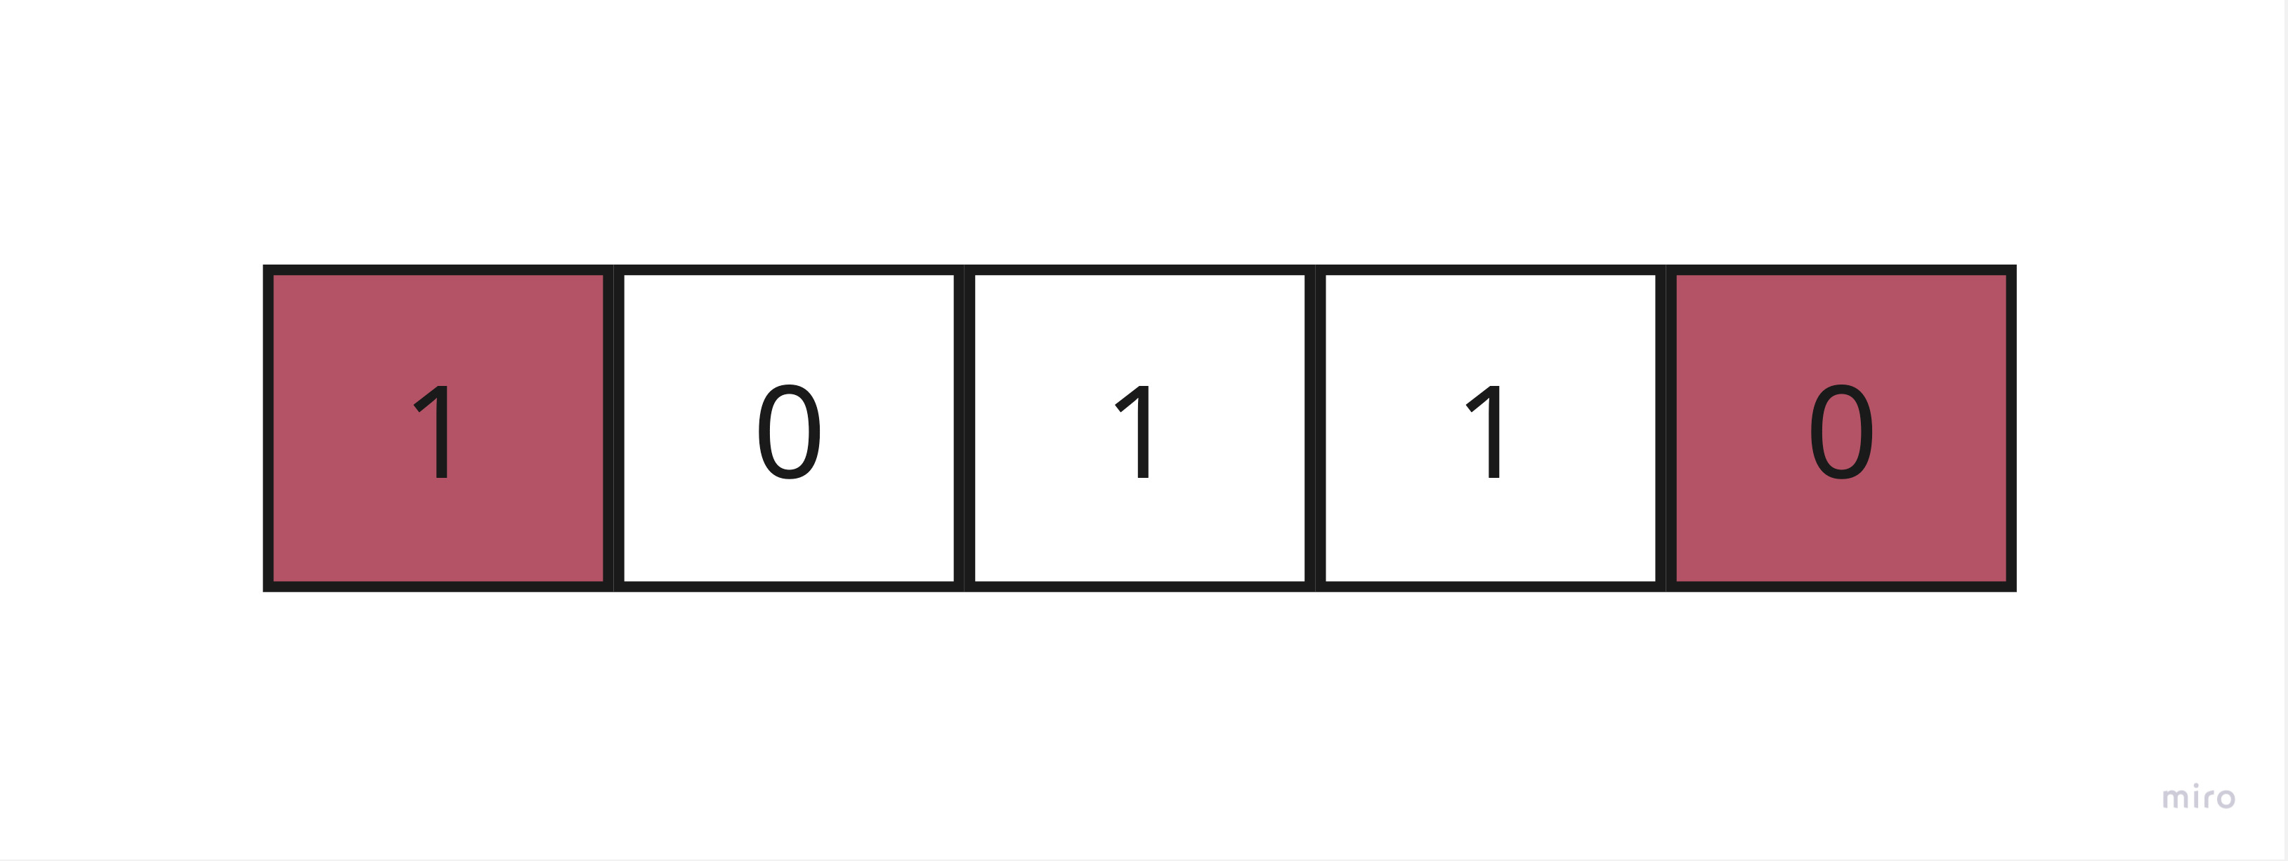
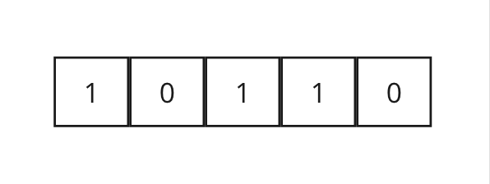
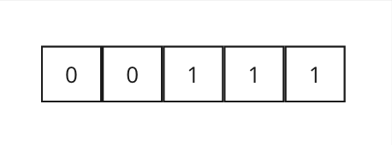
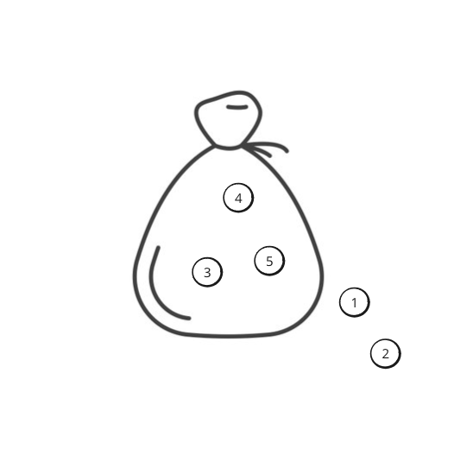
Mutation

Slide 21
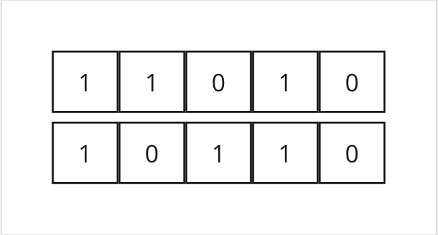
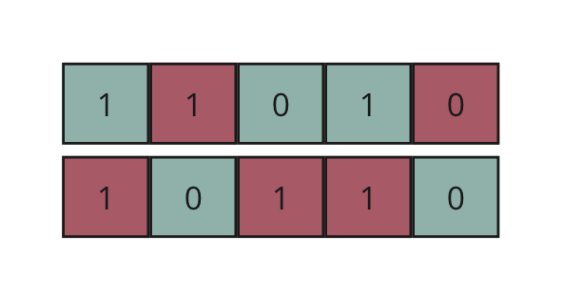

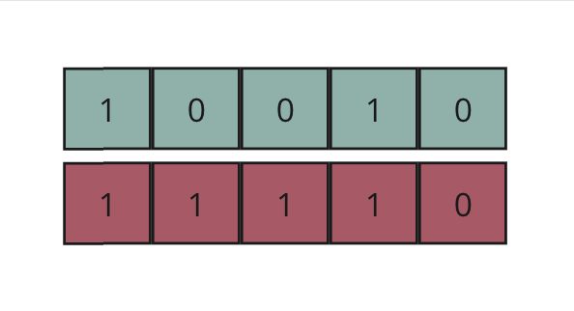
Crossover

Slide 22
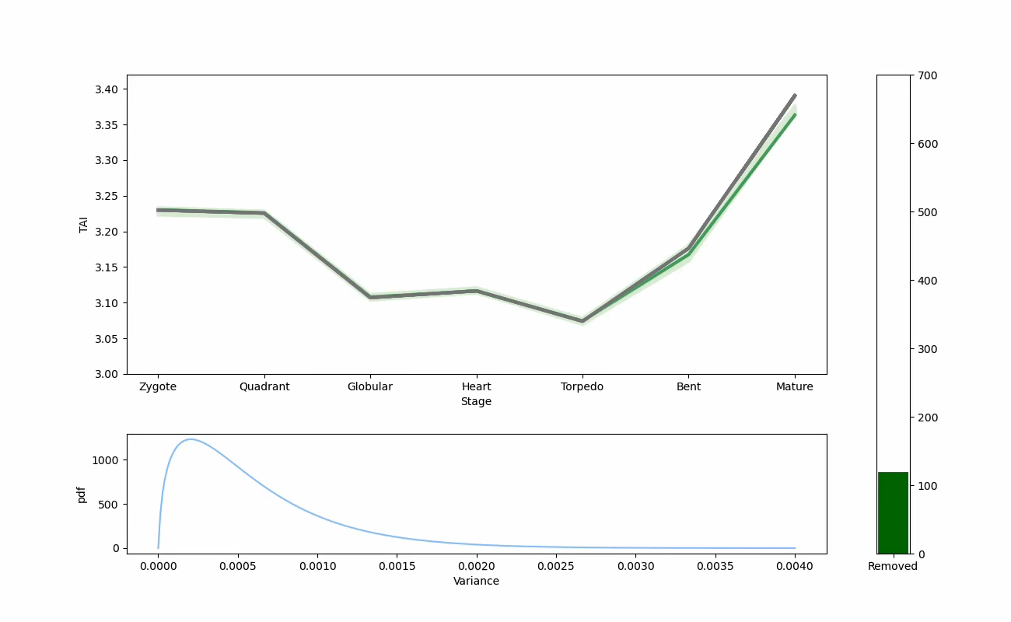
Results

Slide 23
Results
Run time: 1,5h
Number of removed genes: around 160
> 50% in all solutions

Slide 24
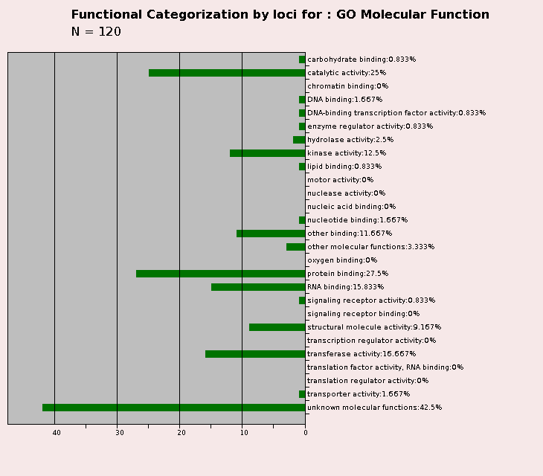
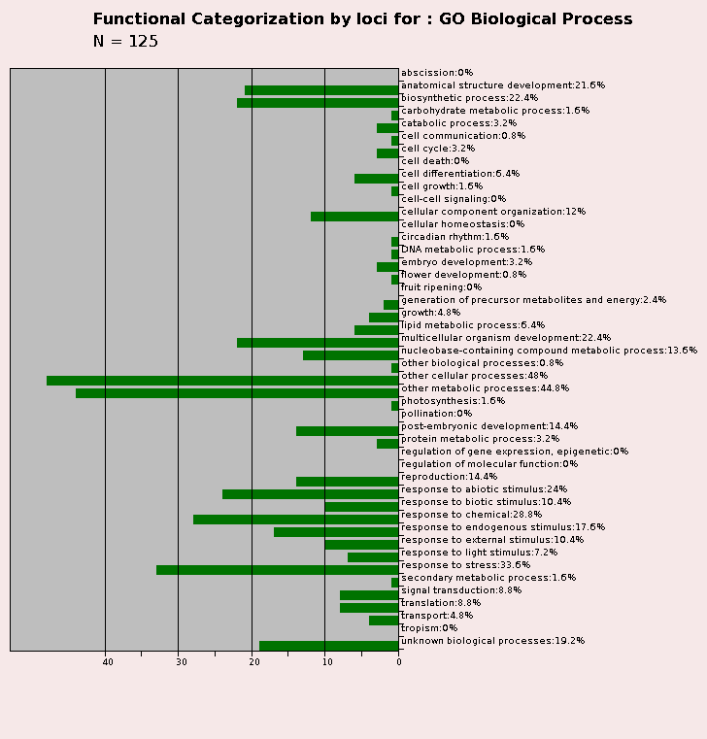
Results

Slide 25
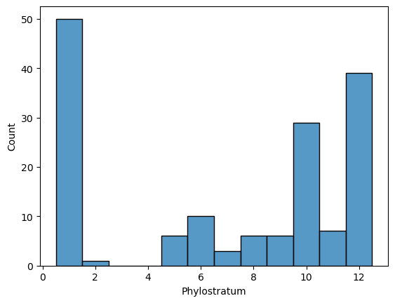
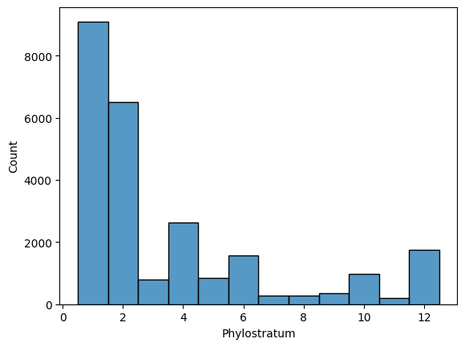
Results
Removed genes
All genes

Slide 26
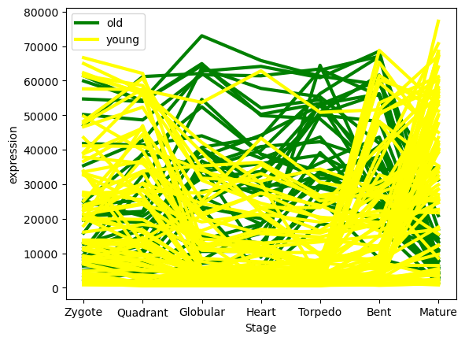
Results

Slide 27
Next steps
Rethinking the used metrics
Data standardization
Further optimization
Validation on more datasets
Inspection of identified genes

Slide 28
